Slide 1
INTRODUCTION TO BACKBONE.JS

Slide 2
What is Backbone
A javascript library that provides helpful types for building and organizing rich javascript interfaces.
Not a framework.
Not MVC.
A library of tools that help build a richer web.

Slide 3
Definition:
Backbone gives structure to the web applications by providing models with key-values binding and custom events, collections with a rich API of enumerable functions, views with declaratives events handling and connects it all to your existing API over a RESTFULL JSON interfaces.

Slide 4
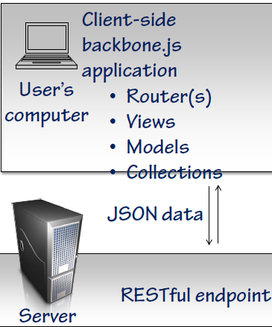

Slide 5
Pros
Fast
Highly interactive
Scalable

Slide 6
Cons
Can not indexed by search Engine (Without Extra Work).
Difficult to test.
Security Issues.

Slide 7
SPAs
SPAS are called Single page application.
Improved User Experience.
Examples
Gmail
Facebook
Twitter
Trello

Slide 8
SPAs Challenges
Lack of Tooling and Experience.
Search Engine Optimization.
Working with Different Browsers.

Slide 9
Why Do We Need Backbone.js
Developing a coherent , readable, structured, testable and maintainable client side application is not easy.
Backbone contain Tools and codified knowledge that minimize Difficulties.

Slide 10
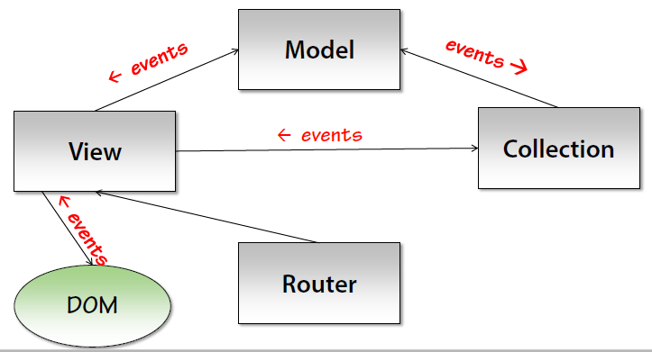
Backbone Solution
Backbone Provides a set of tools for introducing structure to your client-side application

Slide 11
Required Dependencies
UnderScore.js
Function Programming Support for JAVASCRIPT.
JQUERY/ZEPTO
DOM manipulation and AJAX.
ZEPTO is only for modern Browsers.

Slide 12
☺☺☺Thank YOU ☺☺☺

